Slide 1
Business Model Canvas

Slide 2
week 7 deliverables
Elevator Pitch Presentation | The 5min pitch must include - Target problem - Proposed entrepreneurial solution - Justify the need and demand of your product/ service Identify next steps to develop the idea further Add BMC – version 1F | Week 7

Slide 3
Created by Swiss entrepreneur and Strategyzer co-founder, Alexander Osterwalder, the Business Model Canvas is a visual representation of the 9 key building blocks that form the foundations of every successful business. It's a blueprint to help entrepreneurs invent, design, and build models with a more systematic approach.

Slide 4
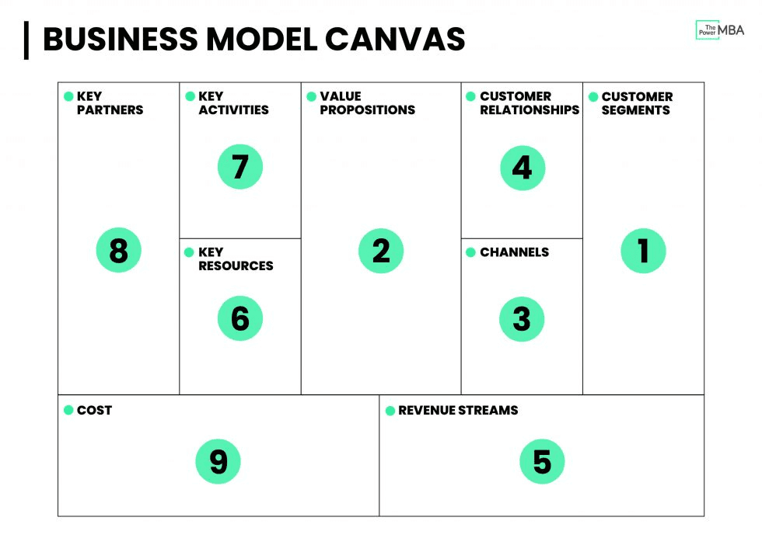
BMC

Slide 5
Business Model canvas
Customer Segments (CS) | The specific groups of people or organizations your business serves.
Value Proposition (VP) | The unique benefit or solution you deliver to solve customer problems.
Channels (CH) | The ways your product or service reaches and communicates with customers.
Customer Relationships (CR) | The type of interaction you establish with each customer segment.
Revenue Streams (RS) | The ways your business earns money from each customer segment.
Key Resources (KR) | The critical assets (physical, human, intellectual, financial) required to run the business.
Key Activities (KA) | The essential actions the business must perform to deliver its value proposition.
Key Partnerships (KP) | The external alliances and suppliers that help the business succeed.
Cost Structure (C$) | The major costs involved in operating and sustaining the business model.

Slide 6
Activity Time

